Slide 1
Introduction to Apache Spark
Week-3
Build your skills when you turn your attention to the popular Apache Spark platform. Explore attribute and benefits of Apache Spark and distributed computing. You'll gain key insights about functional programming and Lambda functions. Explore Resilient Distributed Datasets (RDDs), Parallel Programming, resilience in Apache Spark and relate RDDs and Parallel Programming with Apache Spark. Dive into additional Apache Spark components and learn how Apache Spark scales with Big Data. Working with Big Data signals the need for working with queries, including structured queries using SQL. Learn about the functions, parts and benefits of Spark SQL and DataFrame queries, and discover how DataFrames work with SparkSQL.
Learning Objectives
Describe the attributes and benefits of Apache Spark and distributed computing.
Compare and contrast Apache Spark to MapReduce.
Explain the terms functional programming and Lambda functions.
Relate functional programming to Apache Spark.
Define Resilient Distributed Datasets (RDDs), Parallel Programming, resilience in Apache Spark and relate RDDs and Parallel Programming with Apache Spark.
Describe Apache Spark components and how Apache Spark scales with Big Data.
Define the functions, parts, and benefits of Spark SQL and DataFrame queries, and explain how DataFrames work with SparkSQL.
Create RDDs and apply transformations and actions to them.
Create DataFrames
Filter and aggregate data by using DataFrames and SparkSQL.

Slide 2
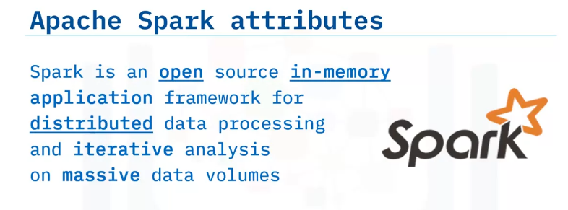
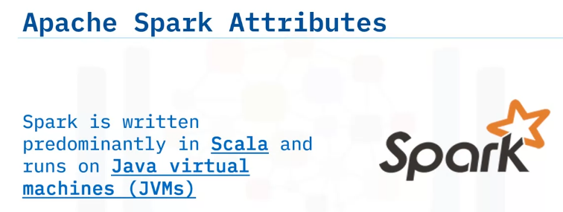
Describe Apache Spark attributes,
describe distributed computing,
list the benefits of Apache Spark and distributed computing,
compare and contrast Apache Spark to MapReduce.
Why use Apache Spark?
Spark is an open-source, in-memory application framework for distributed data processing and iterative analysis on massive data volumes.
Spark is entirely open source.
Spark is available under the Apache Foundation hence the name Apache Spark.
Spark is “in-memory,” which means that all operations happen within the memory or RAM.
Distributed data processing uses Spark. Finally, Spark scales very well with data, which is ideal for massive datasets.
Spark is primarily written in Scala, a general-purpose programming language that supports both object-oriented and functional programming.
Spark runs on Java virtual machines.

Slide 3
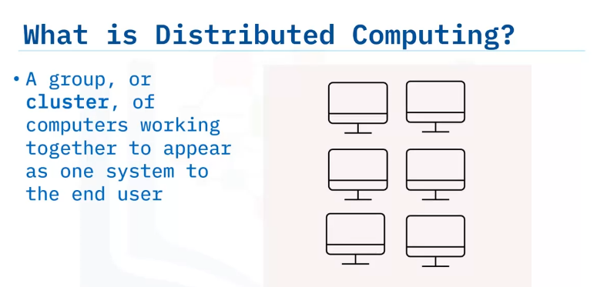
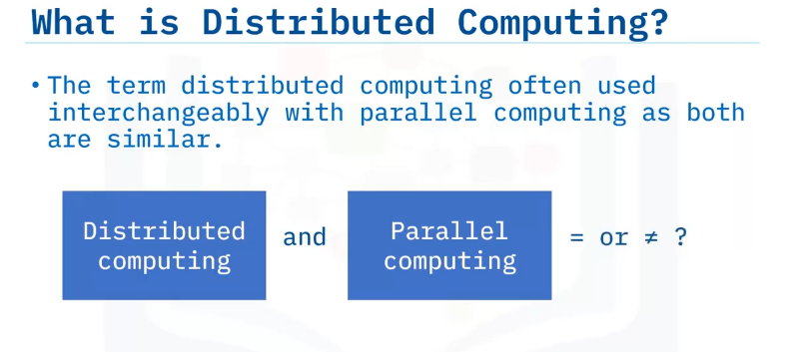
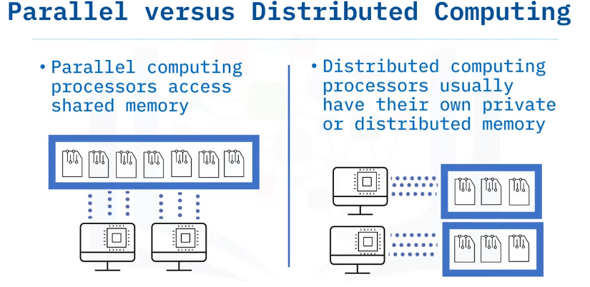
Distributed computing, as the name suggests, is a group of computers or processors working together behind the scenes.
People often use the terms Distributed computing and Parallel Computing interchangeably, as the two computing types have many similarities.
However, distributed computing and parallel computing access memory differently. [Shared RAM]
Typically, parallel computing shares all the memory, while in distributed computing, each processor accesses its own memory/RAM.

Slide 4
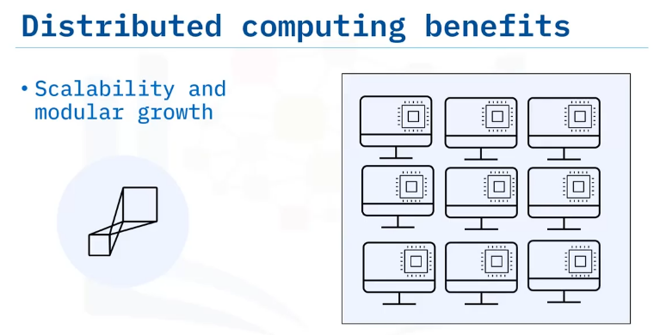
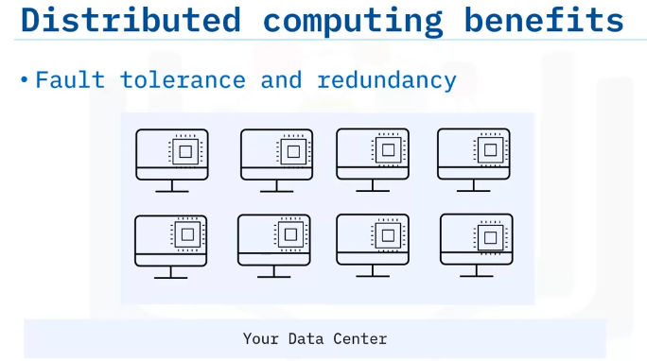
Let’s look at two top distributed computing benefits:
First, distributed computing offers scalability and modular growth.
Distributed systems are inherently scalable as they work across multiple machines and scale horizontally.
A user can add additional machines to handle the increasing workload instead of repeatedly updating a single system, with virtually no cap for scalability.
Second, distributed systems require both fault tolerance and redundancy as they use independent nodes that could fail.
Distributed computing offers more than fault tolerance.
Distributed computing provides redundancy that enables business continuity.
For example, a business running a cluster of eight machines can continue to function whether a single machine or multiple machines go offline.

Slide 5
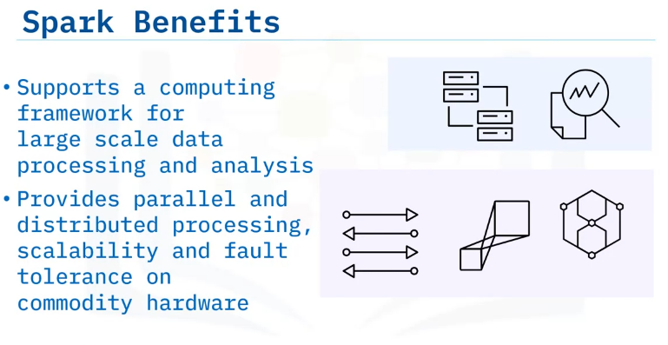
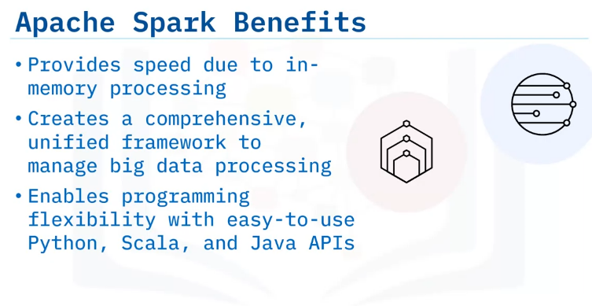
Spark checks the boxes for all the benefits of distributed computing.
Spark supports a computing framework for large-scale data processing and analysis.
Spark also provides parallel distributed data processing capabilities, scalability, and fault-tolerance on commodity hardware.
Spark provides in-memory processing and creates a comprehensive, unified framework to manage big data processing.
Spark enables programming flexibility with easy-to-use Python, Scala, and Java APIs.

Slide 6
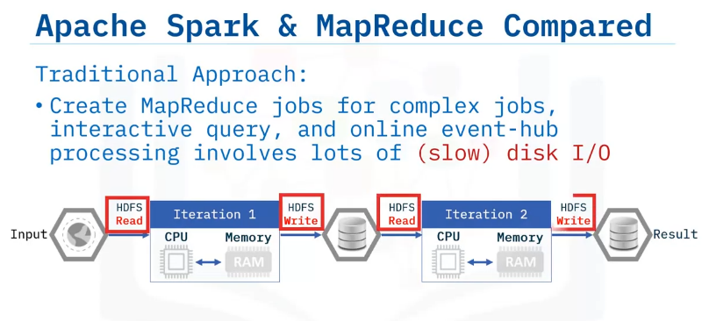
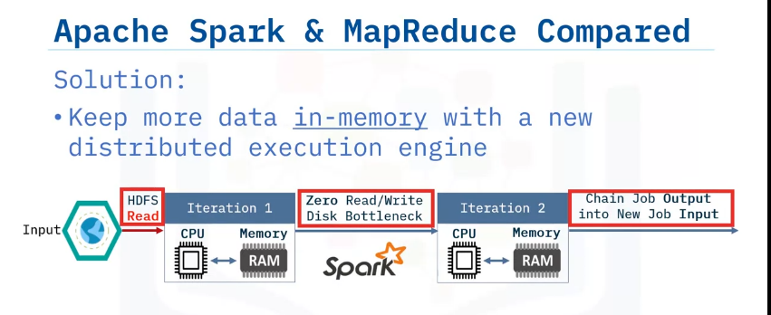
How does Apache Spark compare to more traditional big data tools like MapReduce?
A traditional MapReduce job creates iterations that require reads and writes to disk or HDFS.
These reads and writes are usually time-consuming and expensive.
Apache Spark solves the read/write problems encountered with MapReduce by keeping much of the data required in-memory and avoiding expensive disk I/O, thus reducing the overall time by orders of magnitude.

Slide 7
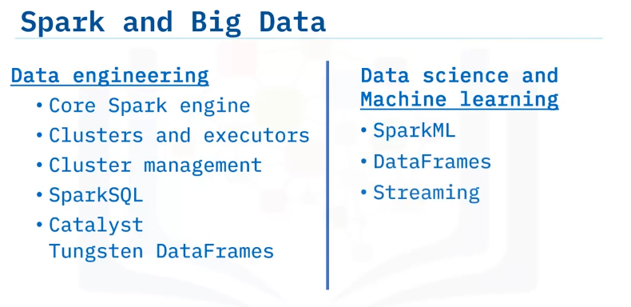
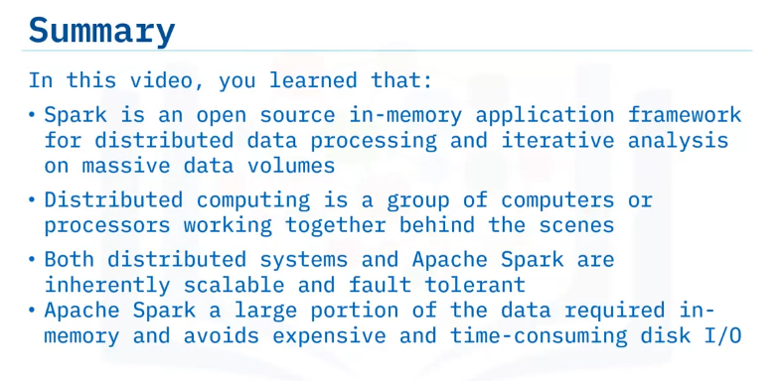
Spark provides big data solutions for both data engineering problems and data science challenges.
Data engineers use Spark tools, including the core Spark engine, clusters and executors and their management, SparkSQL and DataFrames.
Additionally, Spark also supports Data Science and Machine learning through libraries such as SparkML and Streaming.

Slide 8
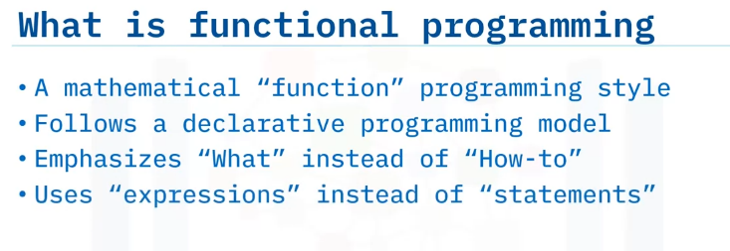
Explain the term functional programming,
explain Lambda functions,
relate functional programming with Apache Spark.
Functional Programming Basics
So, what is Functional Programming? Functional Programming, or FP, is a style of programming that follows the mathematical function format.
Think of an algebra class with the f of x notation.
The notation is declarative in nature as opposed to being imperative.
By declarative, we mean that the emphasis of the code or program is on the “what” of the solution as opposed to the “how to” of the solution.
Declarative syntax abstracts out the implementation details and only emphasizes on the final output, restated, “the what.”
We use expressions in functional programming, like the expression f of x as mentioned earlier.

Slide 9
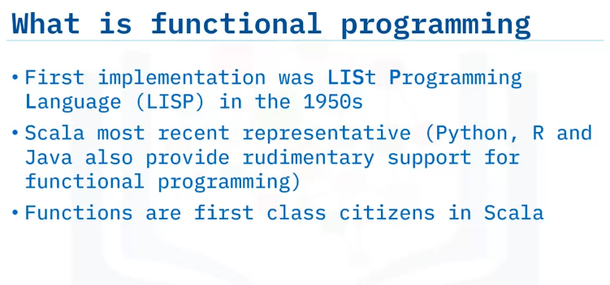
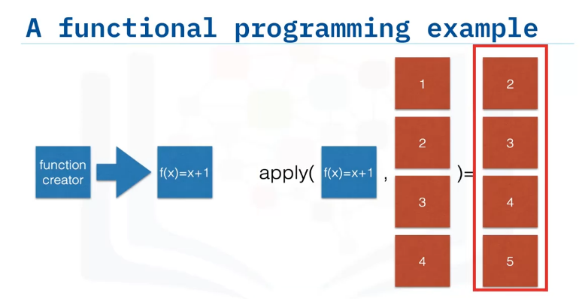
Historically, LISt Processing Language, known as LISP, was the first functional programming language, starting in the 1950s. But today there are many functional programming language options including Scala, Python, R, and Java.
Scala is the most recent representative in this family of programming languages.
Apache Spark is written mainly in Scala, which treats functions as first-class citizens.
Functions in Scala can be passed as arguments to other functions, returned by other functions, and used as variables.
Here is a simple example of a functional program that increments a number by one.
We define the function f of x equal to x +1.
We can then apply this function to a list of size four as shown in the figure, and the program increments every element in the list by one.
That's the advantage of using functional programming. You can directly apply functions to an entire list or array!

Slide 10
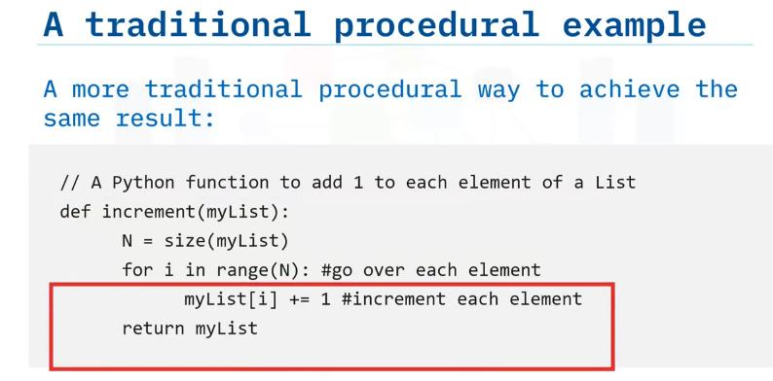
If you perform the same task in an imperative paradigm using procedural code, you would construct a “for-loop” that iterates over the array and increment each element by 1.
This programming paradigm differs from the preceding example by explicitly listing all the steps to be performed, including the “go over” for each element, incrementing each element by one.
This code places emphasis on the “how-to.” Compare and contrast this traditional programming example to the functional programming example that emphasized on the “what” part of the solution.

Slide 11
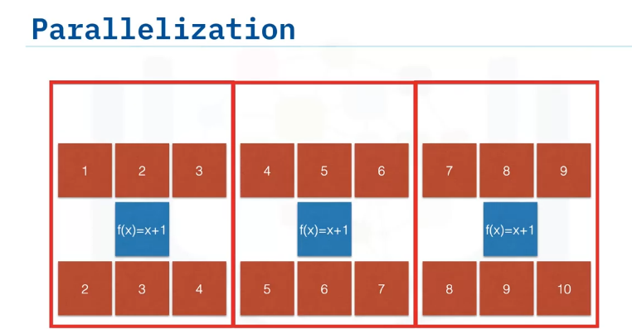
Parallelization is one of the main benefits of Functional Programming.
Consider the previous example where the program incremented by one up to 4.
Here is a larger array, from one to nine. You can split the task into three different computing chunks, which can be referred to as nodes, click one, and run those three tasks or nodes in parallel.
This method's beauty is that you do not need to change any of the function definitions or the code.
All you need to do is to run more than one instance of the task in parallel.
By applying implicit parallelization functional programming capabilities, you can scale the algorithm to any size by adding more compute and resources without modifying the program or code.
The result is the same as if the function exists on only a single node.
However, in this case, the function ran three times in parallel without requiring any changes to the function or code.

Slide 12
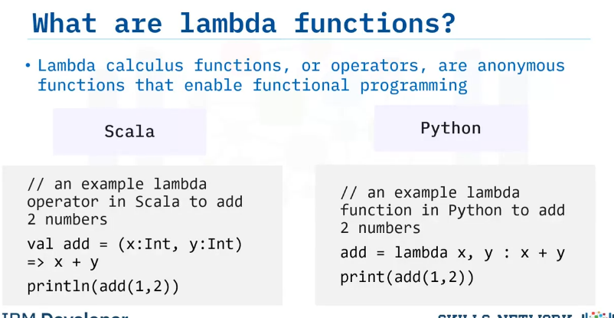
Functional programming applies a mathematical concept called lambda calculus.
To keep the explanation simple, lambda calculus basically says that every computation can be expressed as an anonymous function which is applied to a data set.
Lambda functions or operators are anonymous functions used to write functional programming code.
Here, we have the code written in functional programming style using lambda functions and operators to add two numbers using two popular languages, Scala as seen on the left, and Python, as seen on the right.
Note how both codes are similar in flow, and abstract out the result directly, a hallmark of the declarative paradigm of programming.

Slide 13
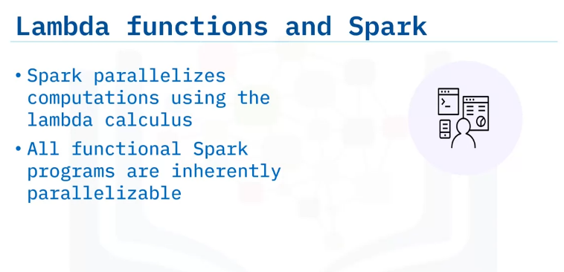
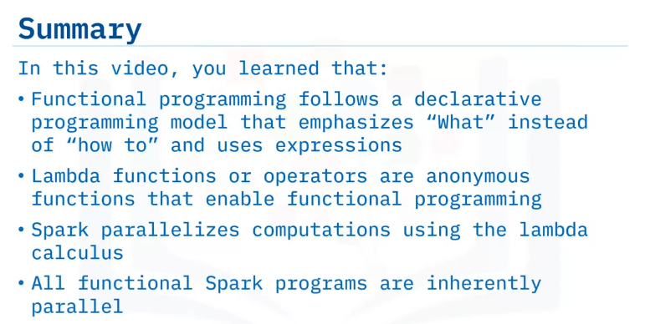
Apache Spark is capable of quickly working through big data, by lambda functions distributing work between worker nodes and parallelized computations.
All Spark programs implemented this way are inherently parallel, so it doesn't matter if you analyze one kilobyte or one petabyte of data.
Just add additional resources to the Spark cluster and you're done

Slide 14
define resilient,
distributed datasets referred to as RDDs;
define parallel programming; explain resilience in Apache Spark;
relate RDD and parallel programming with Apache Spark.
Parallel Programming using Resilient Distributed Datasets

Slide 15
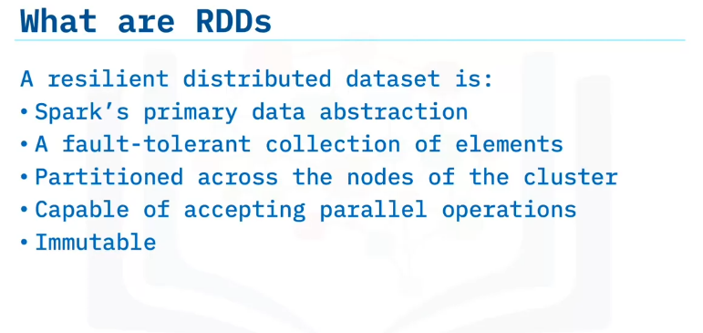
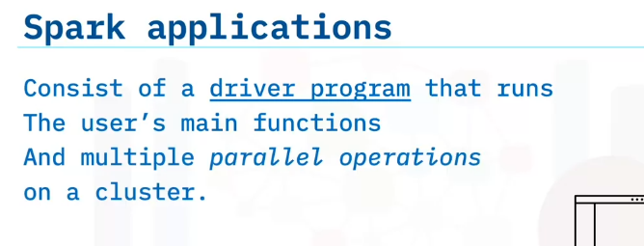
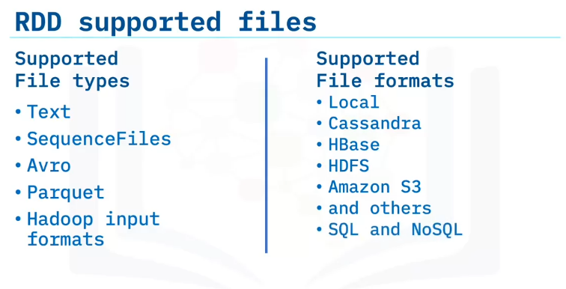
A resilient distributed data set, also known as an RDD, is Spark's primary data abstraction.
A resilient distributed data set, is a collection of fault tolerant elements partitioned across the cluster's nodes capable of receiving parallel operations.
Additionally, resilient distributed databases are immutable, meaning that these databases cannot be changed once created.
Every spark application consists of a driver program that runs the user's main functions and runs multiple parallel operations on a cluster.
RDD's support text, sequence files, Avro, Parquet and Hadoop input format file types.
RDD's also support local, Cassandra, H Base, HDFS, Amazon S3, and other file formats in addition to an abundance of relational and no SQL databases.

Slide 16
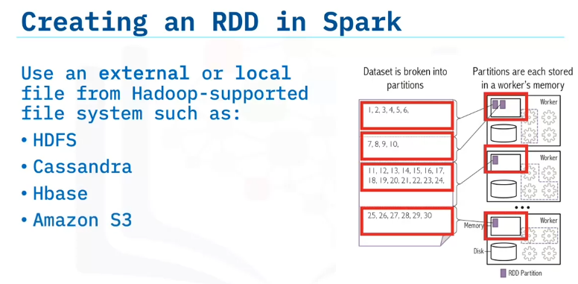
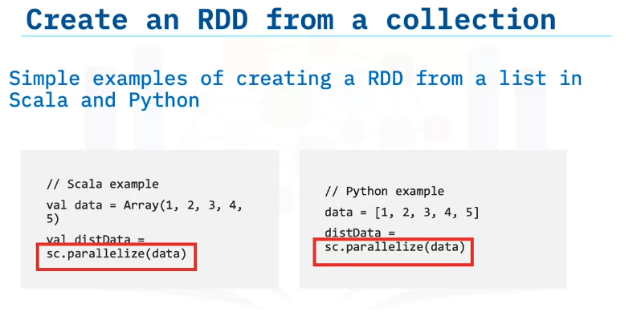
First, you can create an RDD using an external or local file from a Hadoop supported file system such as HDFS, Cassandra, H Base or Amazon S3.
A second method is to apply the parallelize function to an existing collection in the driver program.
Note that this driver program can be in any of the supported high level APIs, including Python, Java, and Scala.
This simple code snippet shown on screen using both Scala and Python creates an RDD from an existing collection.
In this case, we use a list.
You'll see SC applied to the snippet.
One important parameter for parallel collections is the number of partitions specified to cut the dataset.
Spark runs one task for each partition of the cluster.
Typically you want two to four partitions for each CPU in your cluster.
Spark tries to automatically set the number of partitions based on your cluster.
However, you can also set partitions manually by passing the number as a second parameter to the parallelize function.

Slide 17
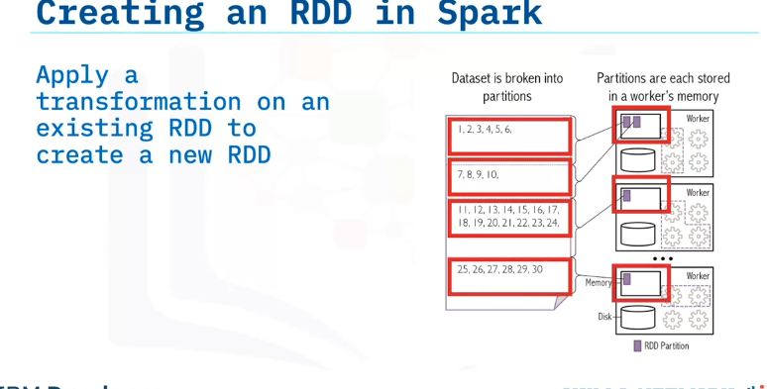
A third method of creating an RDD in Spark is to apply a transformation on an existing RDD to create a new RDD.

Slide 18
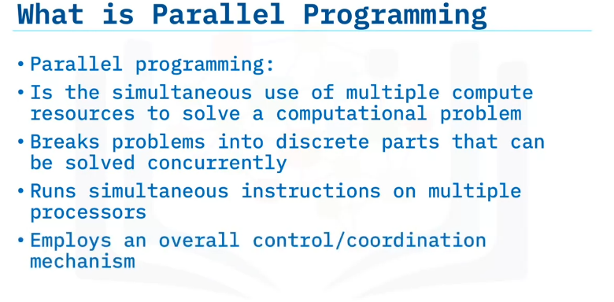
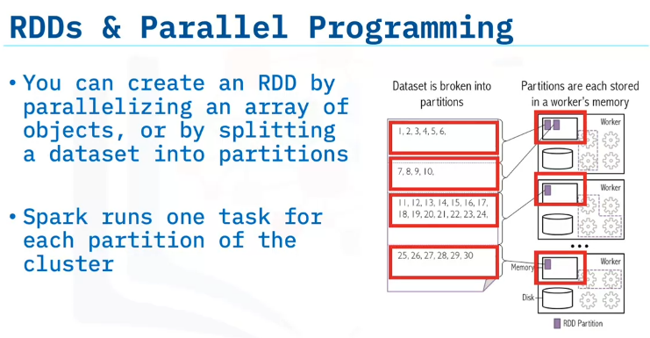
Next, let's define parallel programming.
Parallel programming, like distributed programming, is the simultaneous use of multiple compute resources to solve a computational task.
Parallel programming parses tasks into discrete parts that are solved concurrently using multiple processors.
The processors access a shared pool of memory, which has in place control and coordination mechanisms.
Here is an example of how RDDs enabled parallel programming.
This example is similar to creating an RDD in Spark.
You create an RDD by parallelizing an array of objects or by splitting a dataset into partitions.
Nodes receive the distributed partitions.
Spark runs one task for each partition of the cluster. Based on how RDDs are created, RDDs can inherently be operated on in parallel.

Slide 19
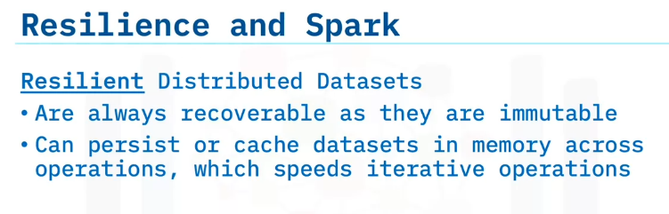
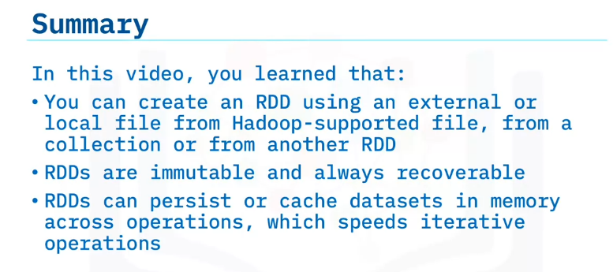
So how do RDDs provide resilience in Spark.
RDD's provide resilience in Spark through immutability and caching.
First RDDs are always recoverable as the data is immutable.
Another essential Spark capability is the persisting or caching of a data set in memory across operations.
The cache is fault tolerant and always recoverable.
as RDDs are immutable and the Hadoop data sources are also fault tolerant.
When you persist in RDD, each node stores the partitions that the node computed in memory and reuses the same partition in other actions on that data set or the subsequent datasets derived from the first RDD.
Persistence allows future actions to be much faster, often by more than 10 times.
Persisting or caching is used as a key tool for iterative algorithms and fast interactive use.

Slide 20
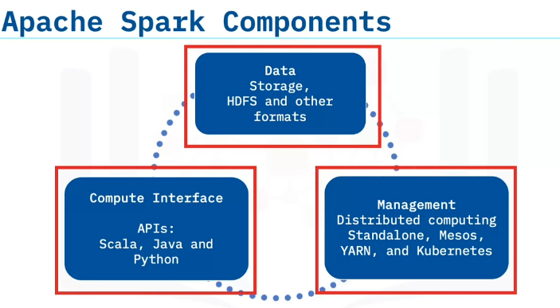
Scale out / Data Parallelism in Apache Spark
Describe Apache Spark components.
Describe how Apache Spark scales with big data.
Apache Spark architecture consists of three main components.
The first component is data storage.
Datasets load from data storage into memory.
Any Hadoop compatible data source is acceptable.
High-level programming APIs comprise the second component.
Spark has APIs in Scala, Python, and Java.
The final component is the cluster management framework, which handles the distributed computing aspects of Spark.
Spark’s cluster management framework can exist as a stand-alone server, Mesos or Yet Another Resource Network, or YARN.
A cluster management framework is essential for scaling big data.
Here is a simple visualization of the three pieces.
The data from a Hadoop file system flows into the compute interface or API, which then flows into different nodes to perform distributed/parallel tasks.

Slide 21
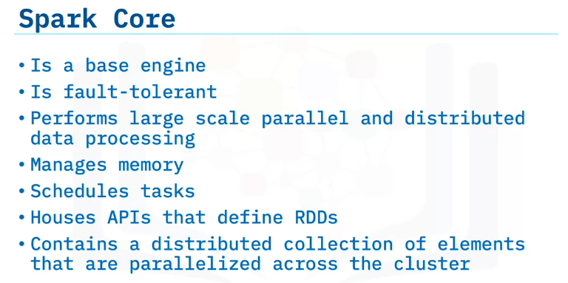
What is often referred to as “Spark” is the base engine formally called the “Spark Core.”
The fault-tolerant Spark Core is the base engine for large-scale parallel and distributed data processing.
Spark Core manages memory and task scheduling.
Spark Core also contains the APIs used to define RDDs and other datatypes.
Spark Core also parallelizes a distributed collection of elements across the cluster.

Slide 22
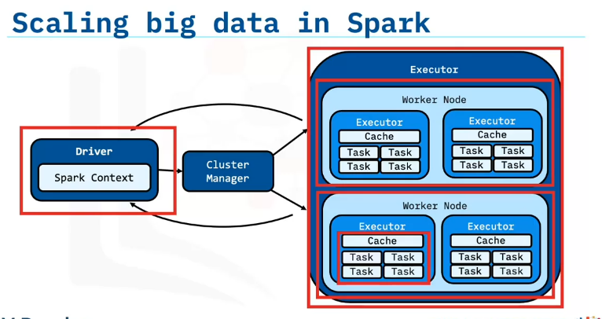
To understand how Spark scales with big data, let’s review the Spark Application Architecture.
The Spark Application consists of the driver program and the executor program.
Executor programs run on worker nodes.
Spark can start additional executor processes on a worker if there is enough memory and cores available.
Similarly, executors can also take multiple cores for multithreaded calculations.
Spark distributes RDDs among executors.
Communication occurs among the driver and the executors.
The driver contains the Spark jobs that the application needs to run and splits the jobs into tasks submitted to the executors.
The driver receives the task results when the executors complete the tasks.
If Apache Spark were a large organization or company, the driver code would be the executive management of that company that makes decisions about allocating work, obtaining capital, and more.
The junior employees are the executors who do the jobs assigned to them with the resources provided.
The worker nodes correspond to the physical office space that the employees occupy.

Slide 23
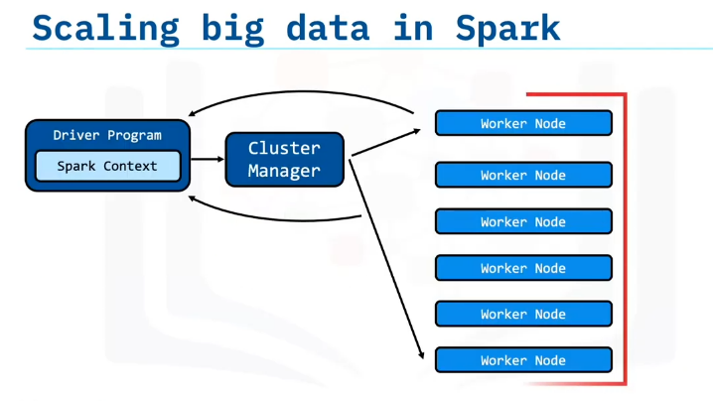
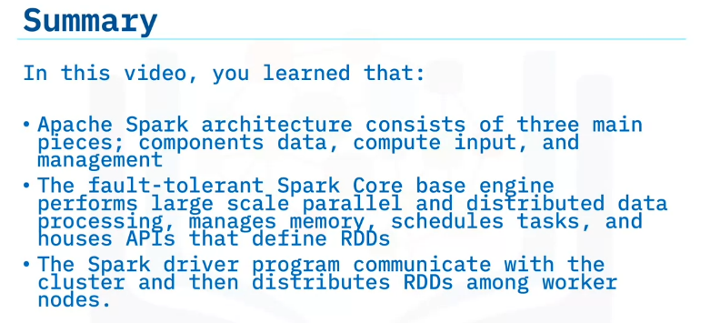
You can add additional worker nodes to scale big data processing incrementally.

Slide 24
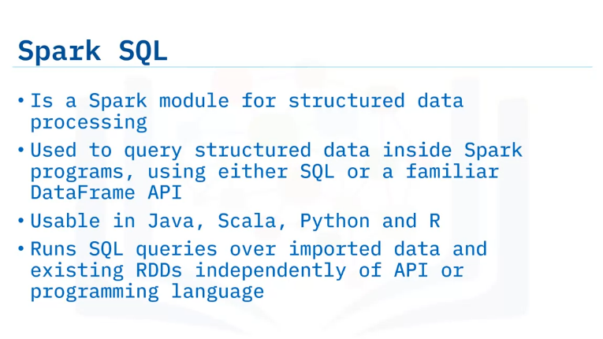
Dataframes and SparkSQL
Define SparkSQL,
define the parts of a Spark SQL query,
explain the benefits of using SparkSQL.
Describe what DataFrames are,
define the parts of a DataFrame query,
explain the benefits of using a DataFrame.
Explain how DataFrames work with Spark SQL.
Spark SQL is a Spark module for structured data processing.
You can interact with Spark SQL using SQL queries and the DataFrame API.
Spark SQL supports Java, Scala, Python, and R APIs.
Spark SQL uses the same execution engine to compute the result
independently of which API or language you are using for the computation.
Developers can use the API that provides the most natural way to express a given transformation.

Slide 25
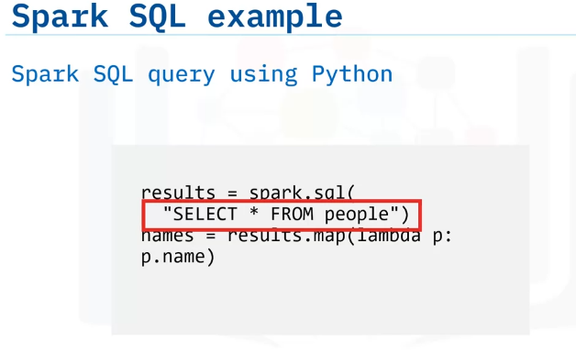
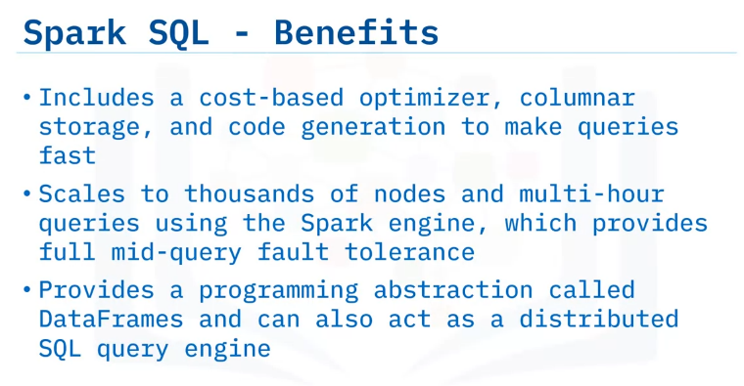
Here is an example of a Spark SQL query using Python.
The query select star from people statement is the SQL query run using Spark SQL.
The entity “people” was registered as a table view before this command.
Unlike the basic Spark RDD API, Spark SQL includes a cost-based optimizer, columnar storage, and code generation to perform optimizations that provide Spark with additional information about the structure of both the data and the computation in process.

Slide 26
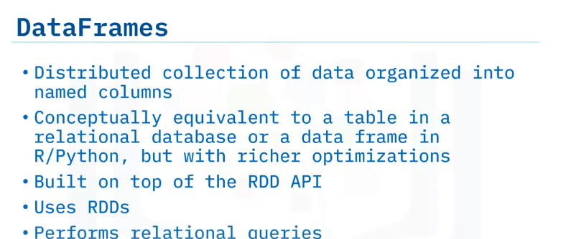
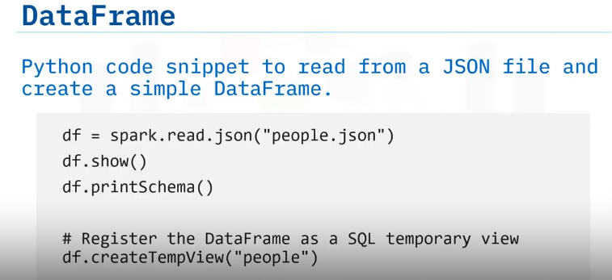
DataFrame : A DataFrame is a collection of data organized into named columns.
DataFrames are conceptually equivalent to a table in a relational database and similar to a data frame in R/Python, but with richer optimizations.
DataFrames are built on top of the Spark SQL RDD API.
DataFrames use RDDs to perform relational queries.
Here is a simple code snippet in Python to read from a JSON file and create a simple DataFrame.
The last step of registering the DataFrame runs SQL queries on this data using Spark SQL.

Slide 27
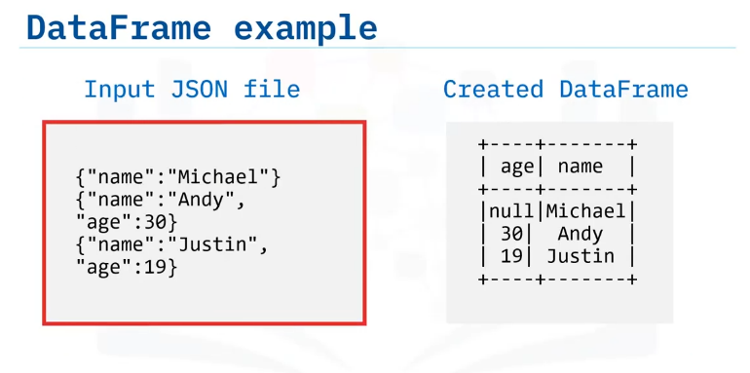
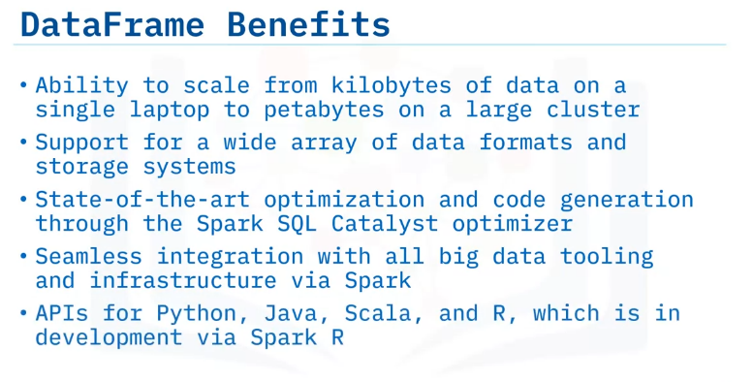
Here you see the input data file in JSON format and the resulting DataFrame.
DataFrames offer many benefits:
DataFrames are highly scalable—from a few kilobytes on a single laptop to petabytes on a large cluster of machines.
DataFrames support a wide array of data formats and storage systems.
DataFrames provide optimization and code generation through a Catalyst optimizer.
Last, DataFrames are developer-friendly, offering integration with most big data tooling via Spark and APIs for Python, Java, Scala, and R.

Slide 28
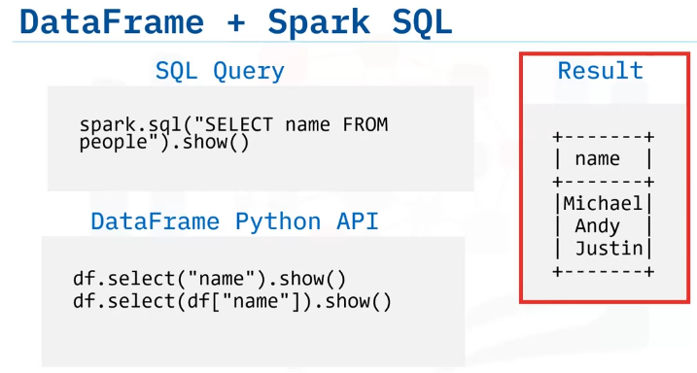
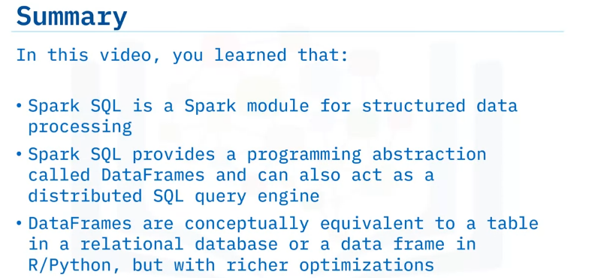
These code snippets show how to run the same SQL query and the result of those queries using Spark SQL.
All three queries show here achieve the same result of showing the names column from our DataFrame.
The first query is a more traditional SQL query, while the other two code examples use the DataFrame Python API to perform the same task.
Similarly, here are two different ways to query the entries in the DataFrame to locate people who are above the age of 21.
The first code example is a SQL query, while the second code example uses the DataFrame API.

Slide 29
Summary & Highlights
In this module, you learned that:
Spark is an open source in-memory application framework for distributed data processing and iterative analysis on massive data volumes. Both distributed systems and Apache Spark are inherently scalable and fault tolerant. Apache Spark solves the problems encountered with MapReduce by keeping a substantial portion of the data required in-memory, avoiding expensive and time-consuming disk I/O.
Functional programming follows a declarative programming model that emphasizes “what” instead of “how to” and uses expressions.
Lambda functions or operators are anonymous functions that enable functional programming. Spark parallelizes computations using the lambda calculus and all functional Spark programs are inherently parallel.
Resilient distributed datasets, or RDDs, are Spark’s primary data abstraction consisting of a fault-tolerant collection of elements partitioned across the nodes of the cluster, capable of accepting parallel operations.You can create an RDD using an external or local Hadoop-supported file, from a collection, or from another RDD. RDDs are immutable and always recoverable, providing resilience in Apache Spark RDDs can persist or cache datasets in memory across operations, which speeds iterative operations in Spark.
Apache Spark architecture consists of components data, compute input, and management. The fault-tolerant Spark Core base engine performs large-scale Big Data worthy parallel and distributed data processing jobs, manages memory, schedules tasks, and houses APIs that define RDDs.
Spark SQL provides a programming abstraction called DataFrames and can also act as a distributed SQL query engine. Spark DataFrames are conceptually equivalent to a table in a relational database or a data frame in R/Python, but with richer optimizations.

